Slide 1


Predicting Customer Satisfaction
Vishweshwar Satpute
Nov 19 Batch ML-1 Project

Slide 2
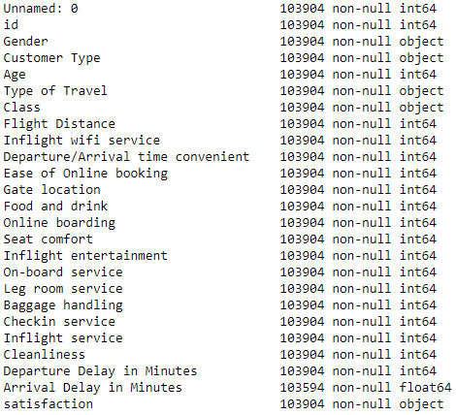
Predicting Customer Satisfaction. Source LINK
The data contains both numerical and categorical columns (20&5)
Problem Statement.
If satisfied what are the factors contributing to it ?
If not satisfied what are the factors contributing to it ?
We want to find a function that will predict the
customer satisfaction ?
creating new columns: Ave Ratings, Total Score, Age Group
and Total Delay, and by dropping columns which do not
help in Prediction.

Slide 3
Observations:
By generating Pandas Profiling :
No duplicates found.
Instance where the value of the rating are ZERO and found Null values.
Departure_Delay_in_Minutes is highly correlated with Arrival_Delay_in_Minutes.
Can drop the columns which do not add value to the customer satisfaction rating

Slide 4
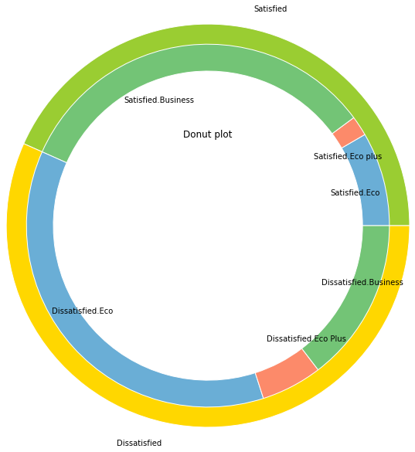
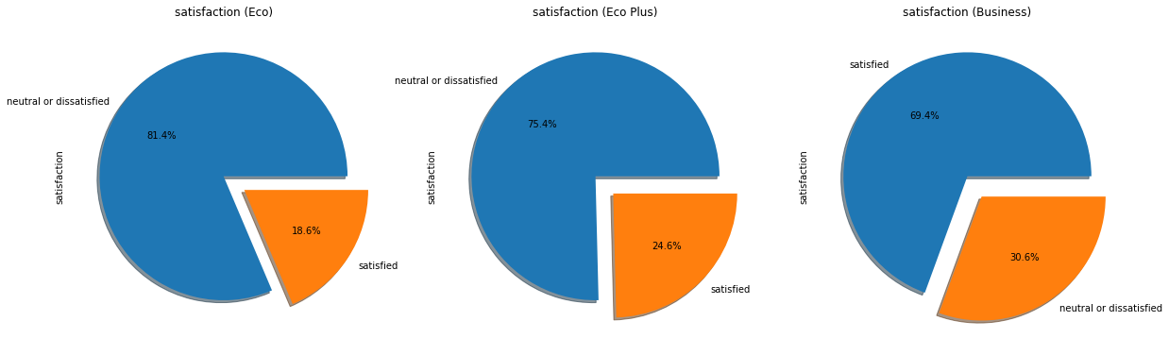
The satisfaction percentages of different Class of customer.
Customer Satisfaction Percentage

Slide 5
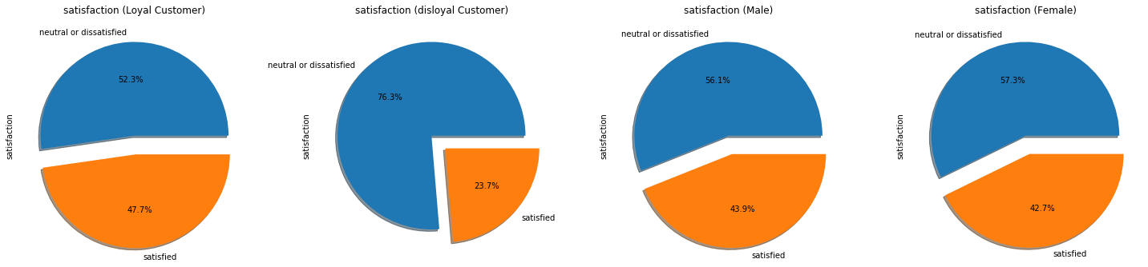
To find out how many Customer are satisfied ?
Let's see how the satisfaction percentages are for Gender
and different type of customer.

Slide 6
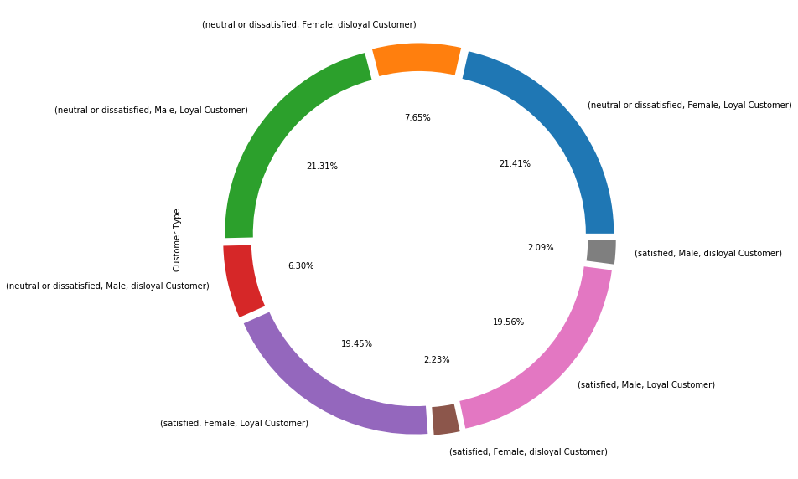
Various Customer with their Satisfaction Percentage

Slide 7
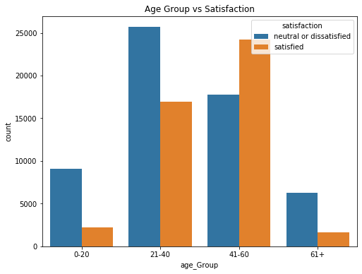
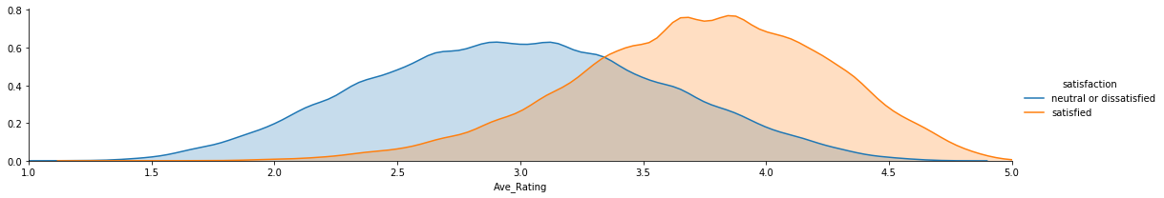
Different Age Group and Their Satisfaction.
The Dissatisfaction rate is much higher
in age group of 0 to 20 and 21 to 40
But higher the age group we can see reduction in dissatisfaction rate.
Average Rating Distribution.

Slide 8
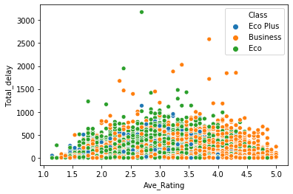
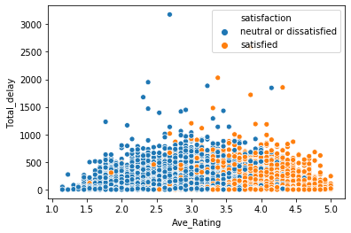
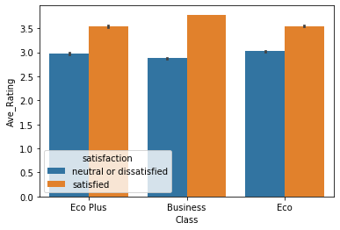
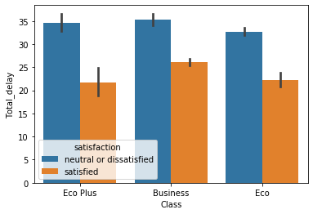
Conclusion
Hence can prove that Departure & Arrival Delay in Minutes has significant higher impact on the customer satisfaction to that off the allover rating.
In Business Class if the Ave Rating is higher customer is still satisfied even if there is a Delay

Slide 9
Machine Learning Algorithm:
Applying Logistic Regression as the target variable is categorical in nature.
Before applying Logistic Regression we have to fix the data.
Doing Dummification on categorical values in order to convert it into numerical form.
Preparing data for Logistic Regression by creating explanatory(X) and Target(y) variables
Further dividing the data in to Train(X,y) and Test(X,y) (80:20)
Applying Logistic Regression, and predicting the values in y_pred_train and y_pred_test.
Now need to Evaluate the Model.
Confusion Matrix.
Accuracy, Error%, Precision, Recall.

Slide 10
Confusion Matrix
True positives (TP): These are cases in which we predicted yes and are actually yes.
True negatives (TN): We predicted no, and no in actual.
False positives (FP): We predicted yes, but actual is no. (Type I error)
False negatives (FN): We predicted no, yes in actual. (Type II error)
Predicted
Actual |  | Dissatisfied | Satisfied
 | Dissatisfied | 10226(TN) | 1649(FP)
 | Satisfied | 2040(FN) | 6866 (TP)

Slide 11
Model Evaluation Metrics:
Accuracy: 0.8224820749723305
Precision: 0.8063417498532003
Recall: 0.7709409386930159
Accuracy: Overall, how often is the classifier correct?
Accuracy = (TP+TN)/total
Precision: When it predicts yes, how often is it correct?
Precision = TP/predicted yes
True Positive Rate(Sensitivity or Recall): When it’s actually yes, how often does it predict yes?
Recall = TP/actual yes

Slide 12



Thank You
Vishweshwar Satpute
satputevishweshwar@gmail.com

